Slide 1
DANGER OF THE TECHNOLOGY ADDICTION

Slide 2


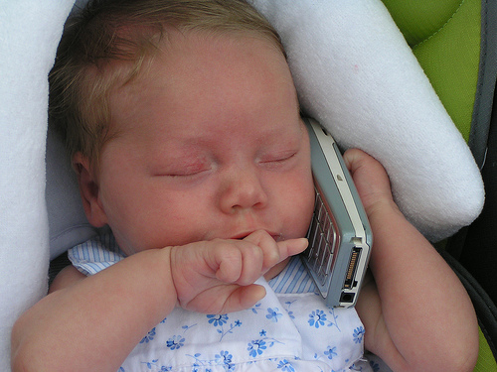




Stop it
They deserve a REAL childhood!

Slide 3


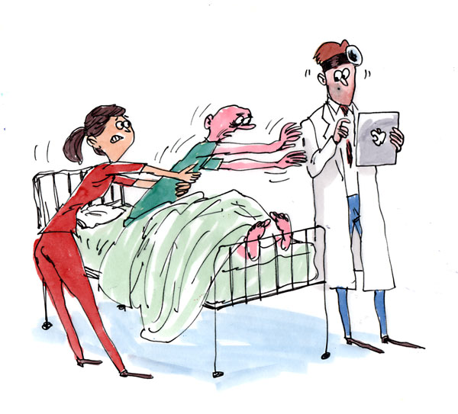

Internet addiction 'damages brain'
“The majority is mildly addicted to technology”
Is Internet Addiction Real?

Slide 4
Death caused by computer game
13-Year-Old Murders Woman for Subscription Money
In 2007, A 13-year-old boy named Dinh The Dan killed an 81-year-old woman and stole her money in order to fund an online gaming addiction. Vietnamese police report that Dan strangled the woman with a piece of rope, then buried her in a pile of sand in front of his house. Owing to his age, he was not sent to prison, but to a reeducation camp from which he will be released after good behavior.
Vengeance Killing for Virtual Sword
Qiu Chegwei lent his Dragon Sabre for the online game Legend of Mir 3 to his friend Mr. Zhu Caoyuan. Mr. Zhu being a resourceful a-hole, sold that thing for about $675. Mr. Chegwei, though, being a bigger a-hole and less resourceful, stabbed the hell out of his friend with a very real knife, killing him. Mr. Chegwei is currently serving a life sentence, which could be suspended to 15 years for good behavior.
Everybody probably remembers the massacre that took place in 1999 in theColumbine High School, Colorado when two pupils murdered twelve of their friends and teachers before committing suicide. Investigation proved that the two of them were big Doom fans and that they used to play this game every day. You cannot claim that the game directly induced this (as many other kids had been playing it without killing their friends and teachers), but it certainly had some influence.

Slide 5





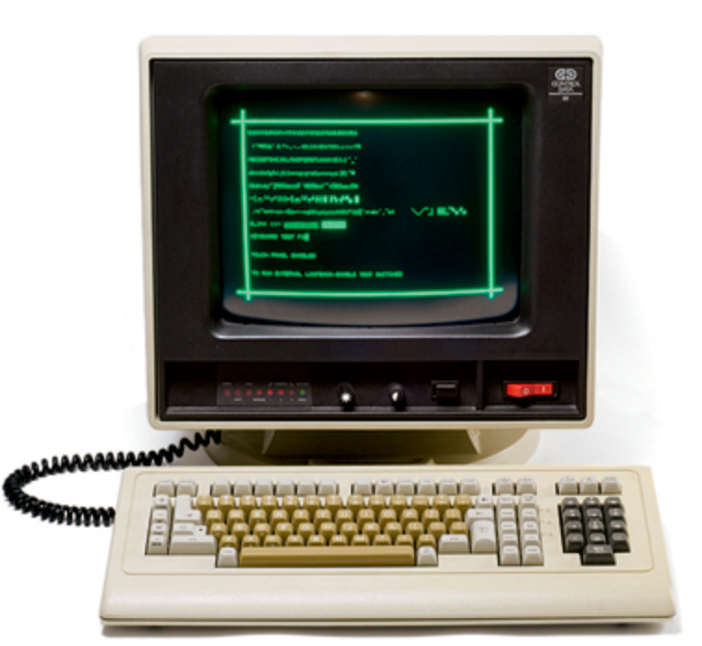

A long time ago
NOW
1950s
1980s

Slide 6



SURVEY RESULTS
3 blocks
ACTION
COMMUNICATION
“WHAT IF”

Slide 7
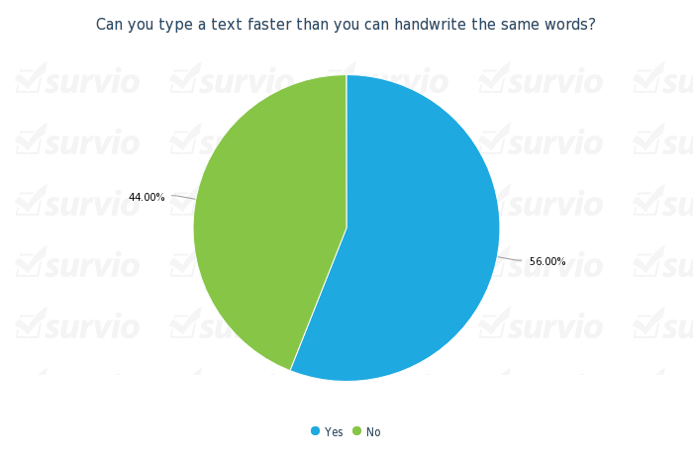


☺

Slide 8


☺

Slide 9

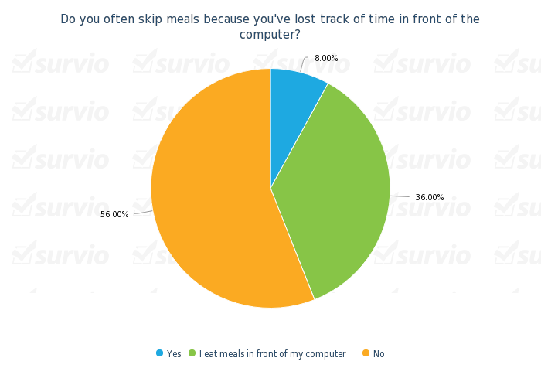


☺
☺

Slide 10
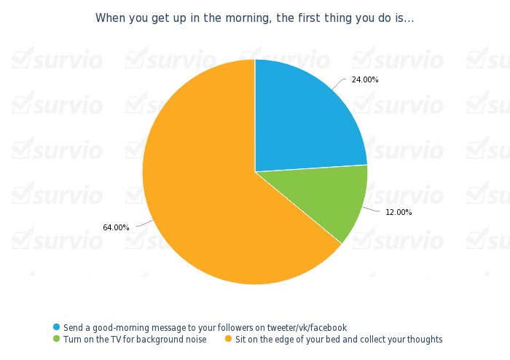

☺

Slide 11
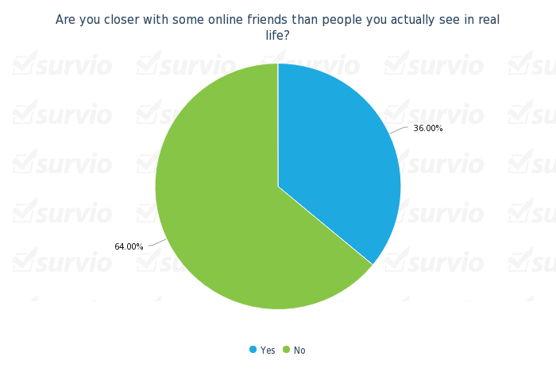

☺

Slide 12
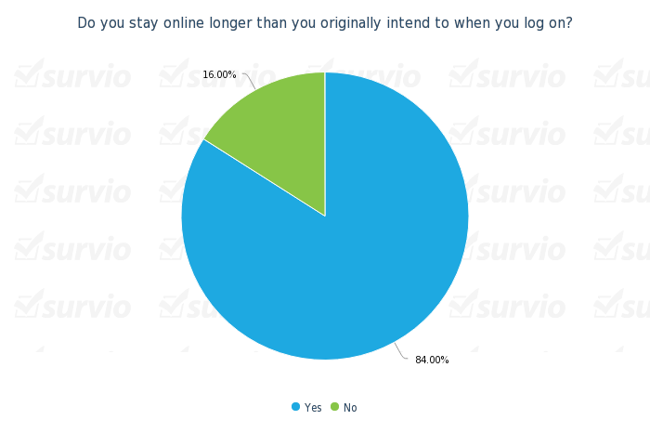
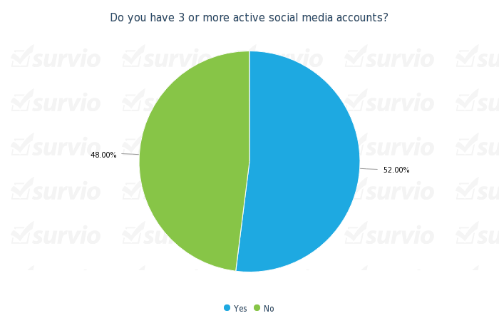
☹
☹

Slide 13
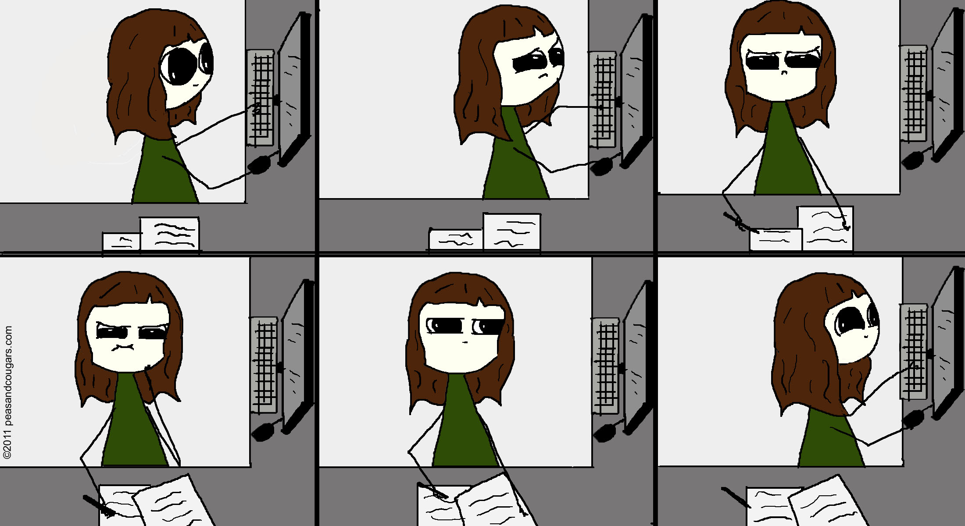

Slide 14
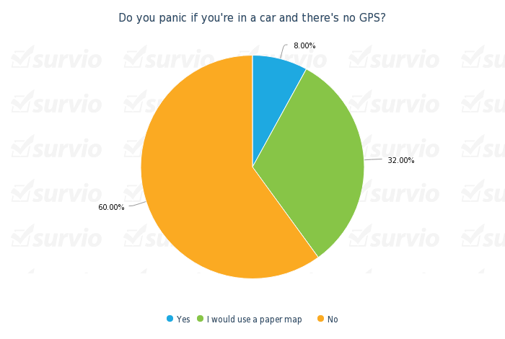

☺

Slide 15
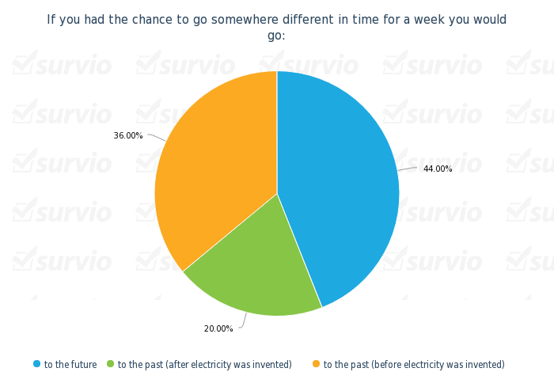

☺

Slide 16






